Slide 1
Environment Setup for Mahout User based and Item based Recommendations

Slide 2
Download eclipse or any other Development environment you are familiar with (for JAVA)
http://www.eclipse.org/downloads/packages/eclipse-ide-java-ee-developers/mars2

Slide 3
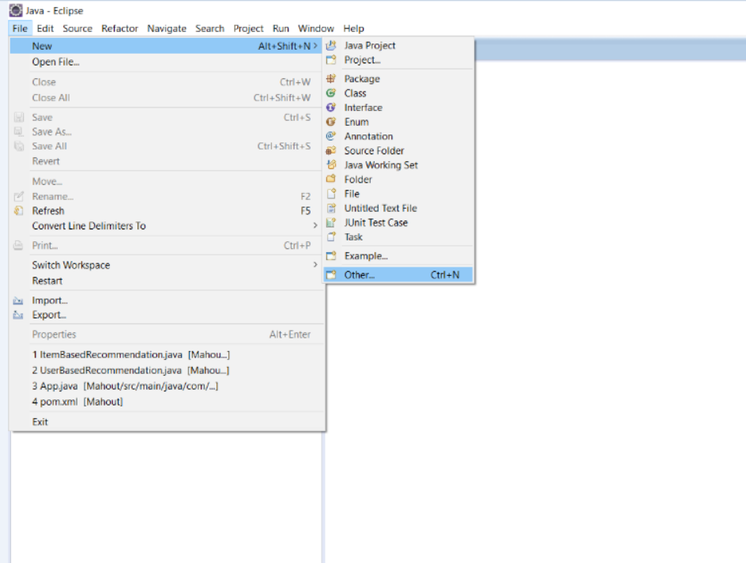
In eclipse go to file->new->other

Slide 4
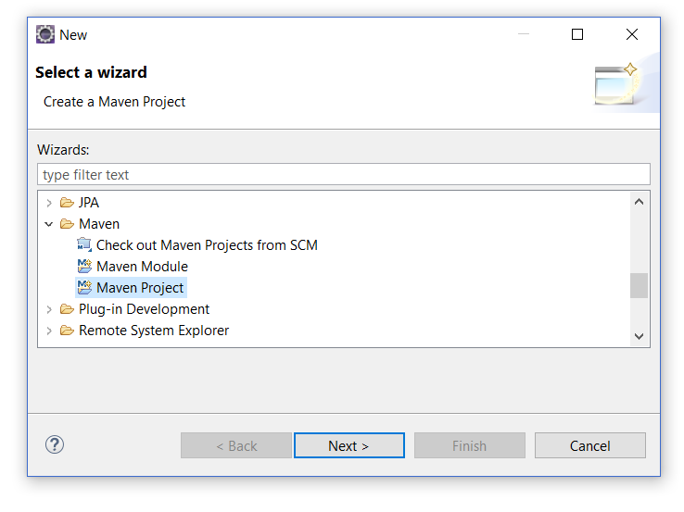
In Others, click on maven project and click on next.

Slide 5
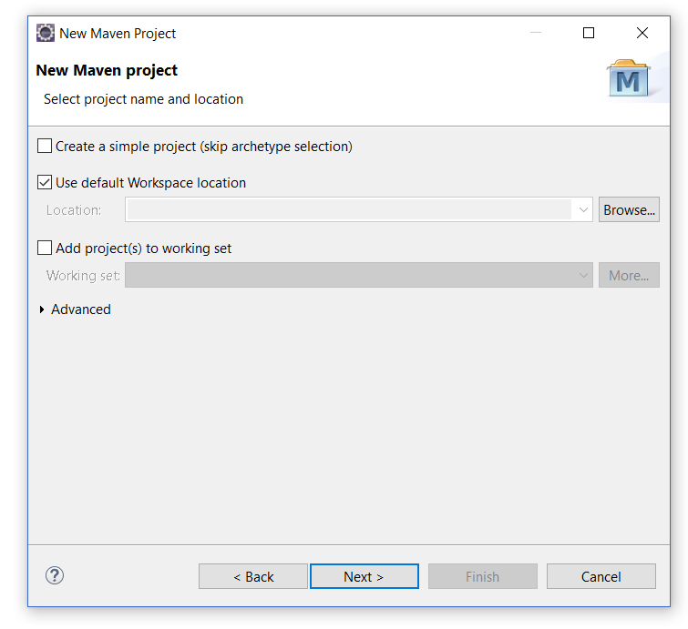
Click next on this screen

Slide 6
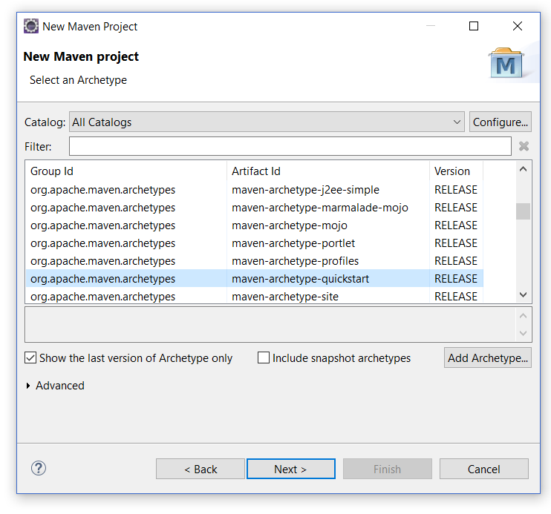
Click next on this screen also

Slide 7
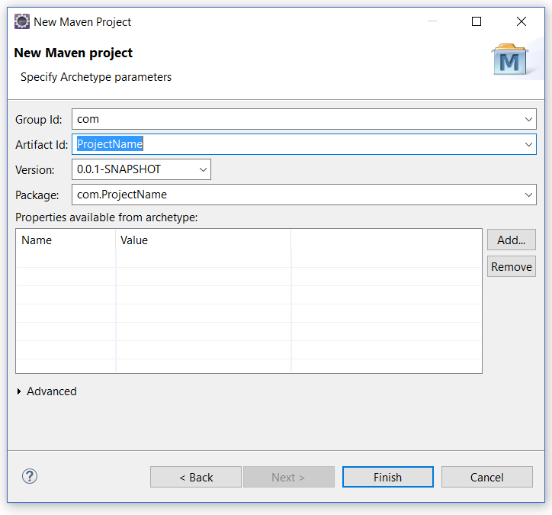
Give Project Related Name

Slide 8
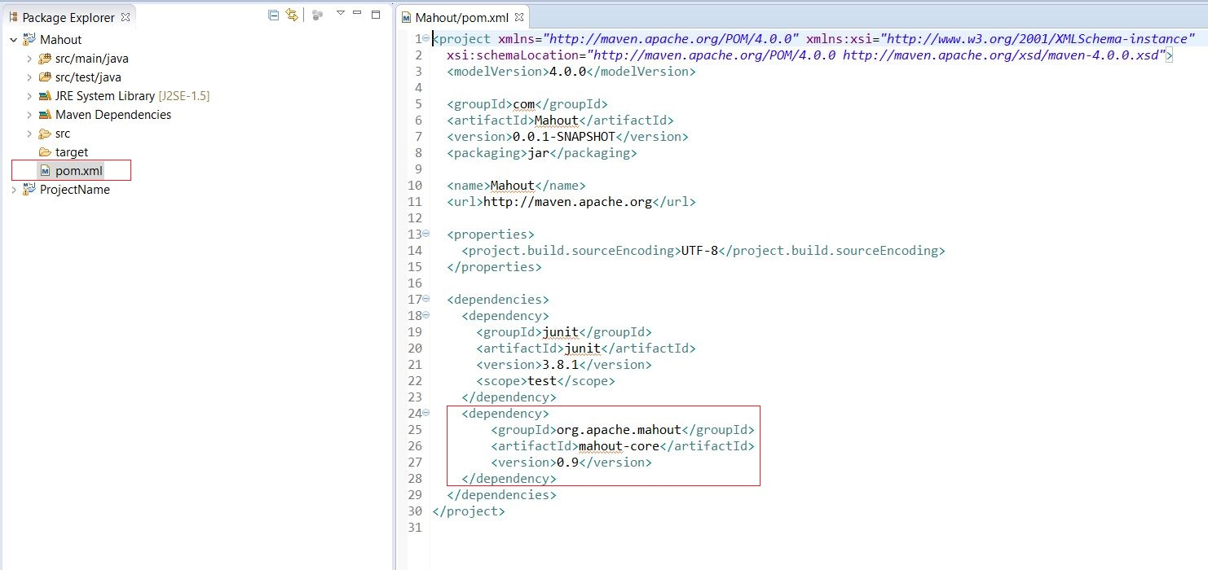
Click on pom.xml and copy/paste highlighted part (highlighted part is available on this link) http://mvnrepository.com/artifact/org.apache.mahout/mahout-core/0.9

Slide 9
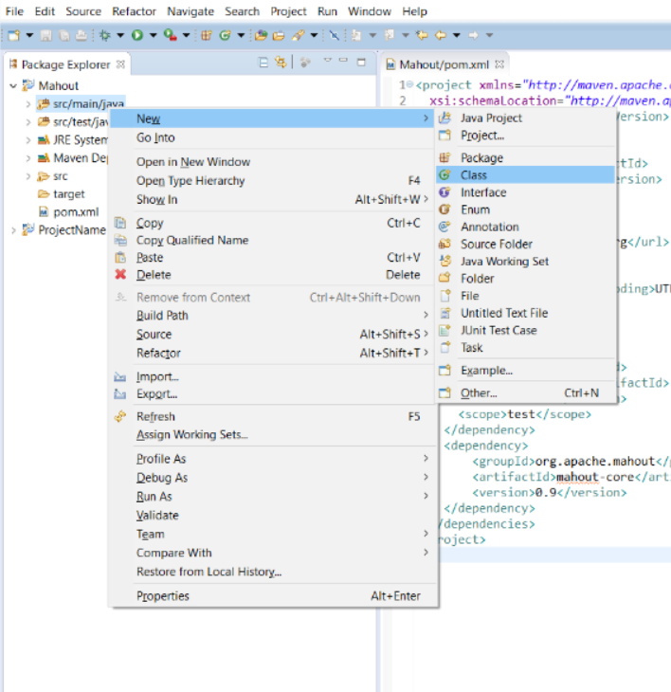
Right Click on src/main/java select new ->class.

Slide 10
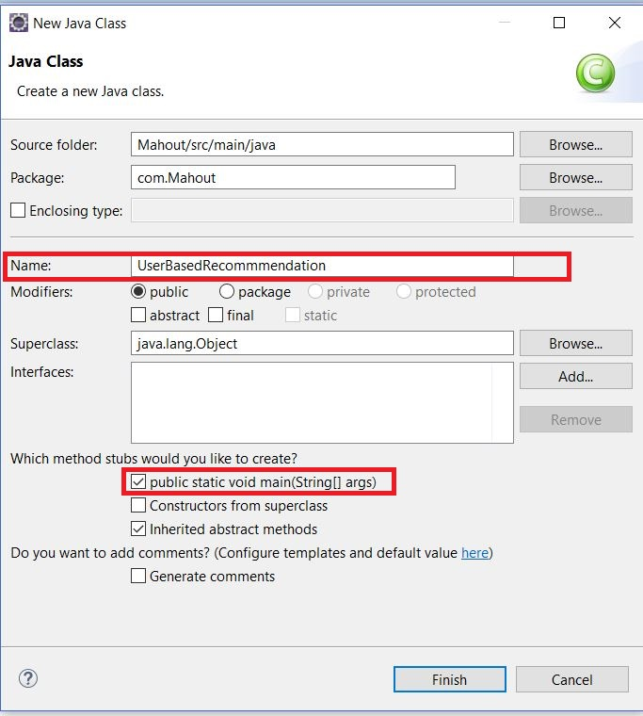
Give ClassName as “UserBasedRecommendation” and select the marked checkbox (If building Item based recommendation give class name as “ItemBasedRecommendation”)

Slide 11
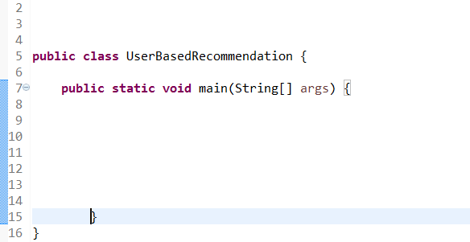
Now, below screen appears , which is your program.

Slide 12
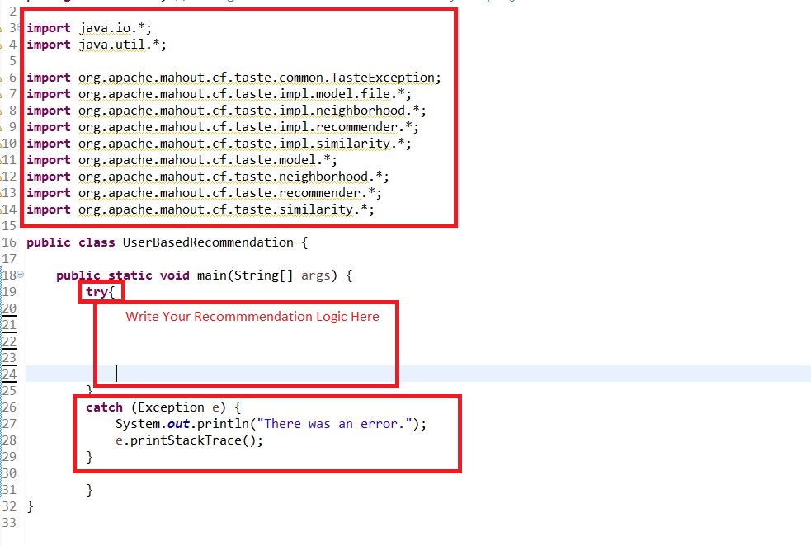
Write recommendation logic in between as Highlighted. Make sure to import all the mentioned things (Copy/Paste from ProgramSkeleton file). Make sure to have try and catch block in place.

Slide 13
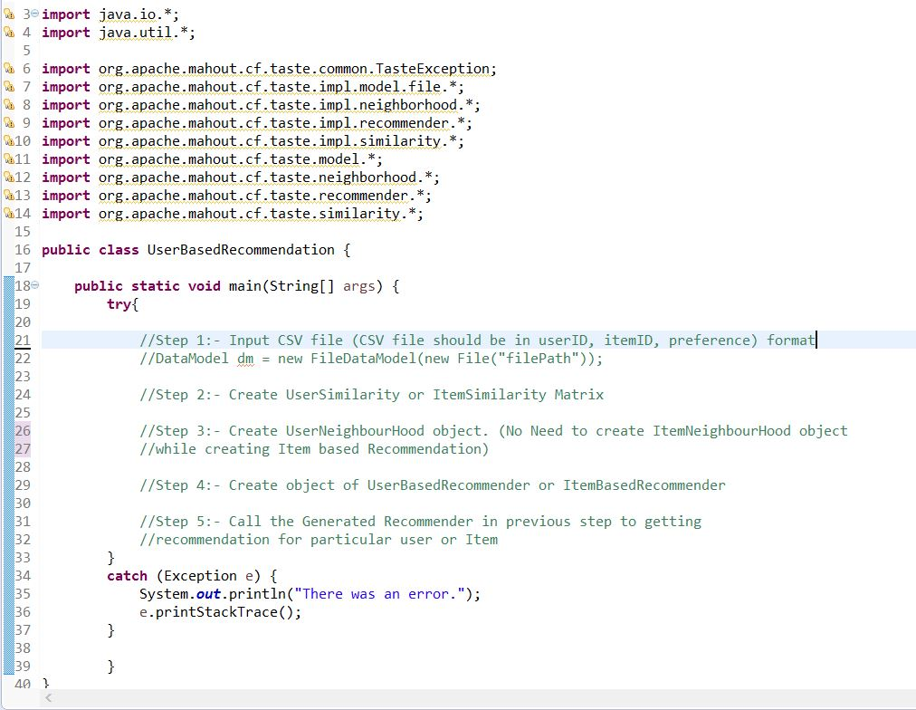
Structure/Logic of your program

Slide 14
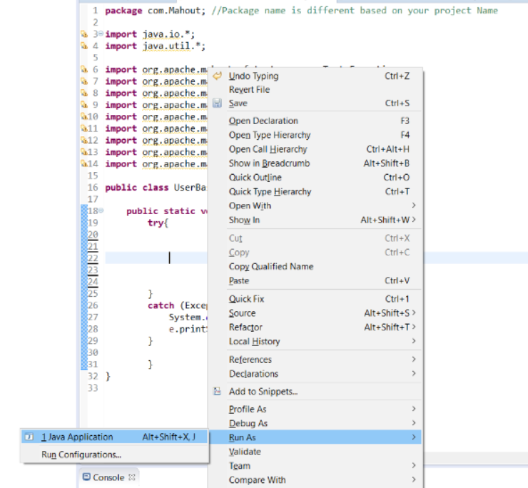
After creating program, right click on screen and Run As -> Java Application See the output in console part.

Slide 15
References (Use this for detailed explanation on algorithms)
https://mahout.apache.org/users/recommender/userbased-5-minutes.html

